Slide 1
map final updated
File created on: 8/5/2021 11:02:23 PM

Slide 2
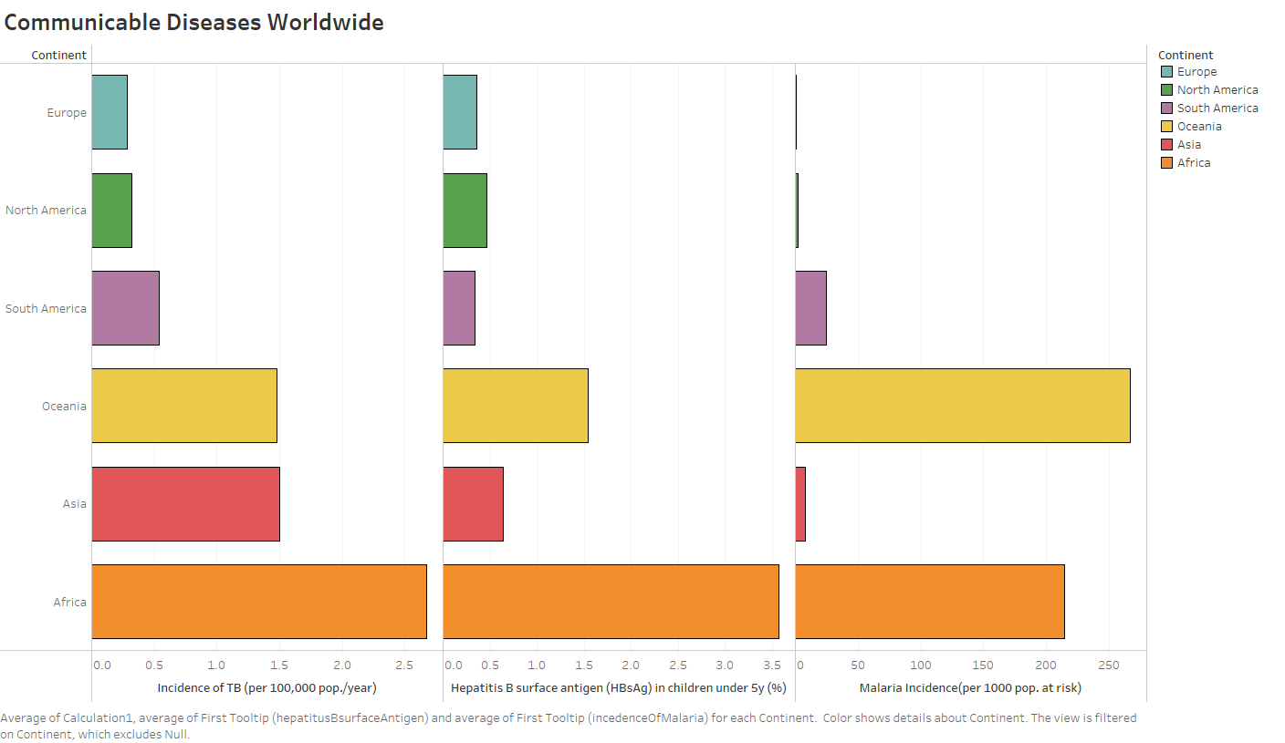

Slide 3
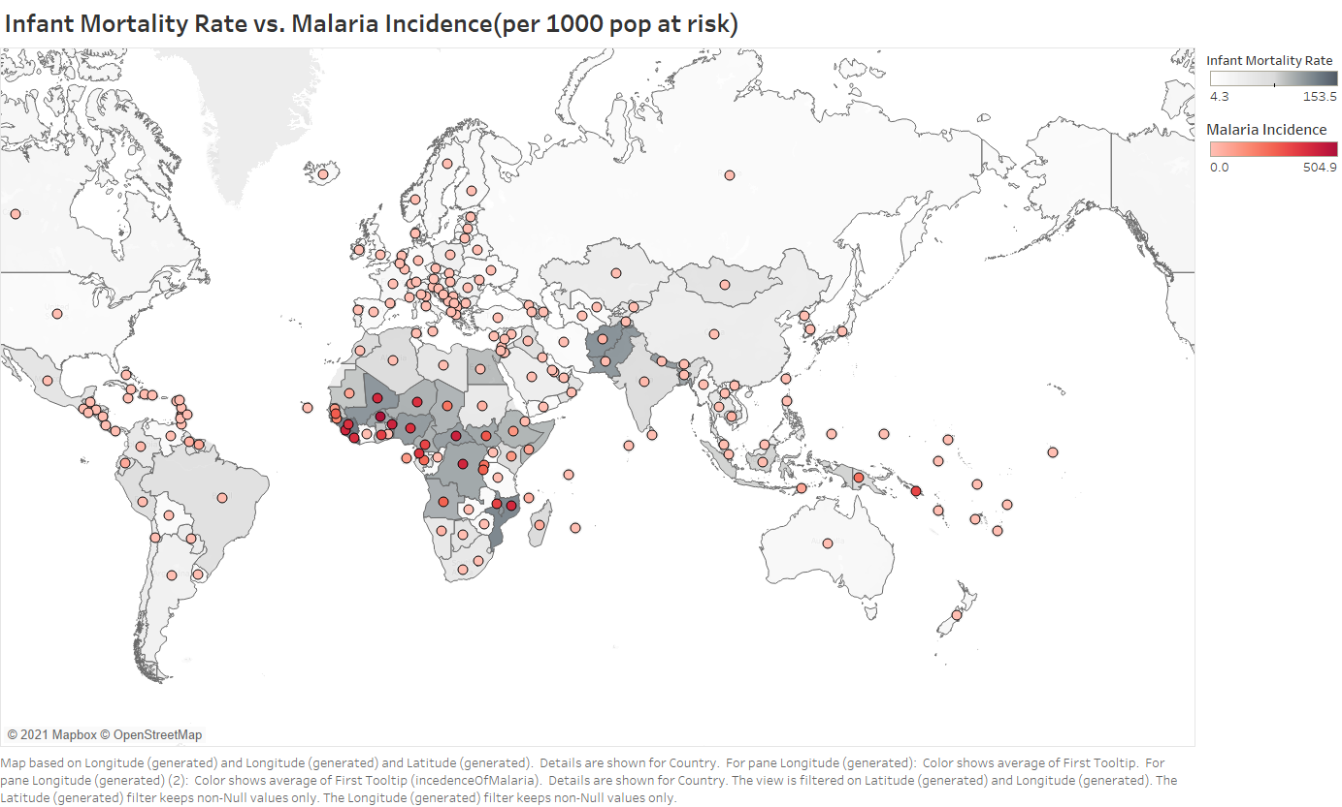

Slide 4
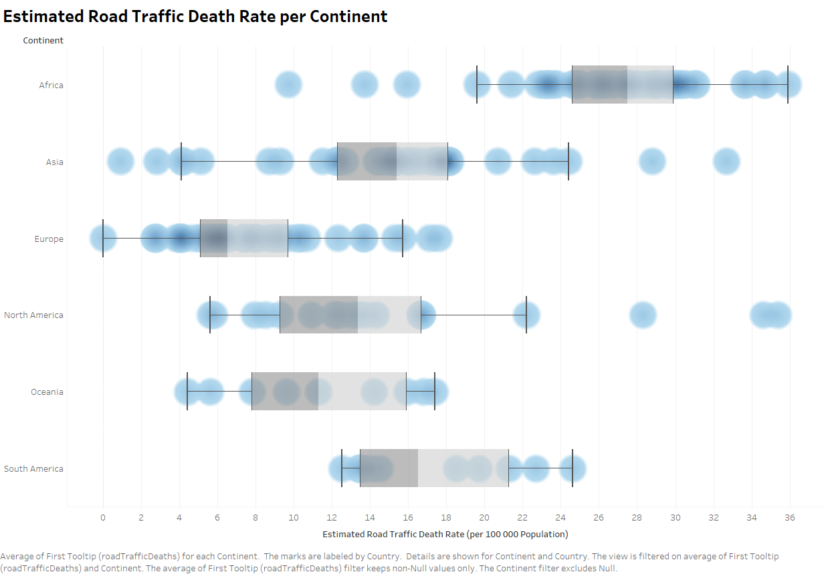

Slide 5
